Slide 1
Thinking the
Bayesian Way
How we update our beliefs when new evidence arrives —
and why it matters more than you think
Thomas Bayes · 1763

Slide 2
THE CORE IDEA
What is Bayesian Thinking?
Rather than asking “is this hypothesis true or false?” — Bayesian thinking asks: How should I revise my belief, given what I just observed?
Start with a Prior
Observe Evidence
Update to Posterior
Your belief before seeing any evidence. Could be a base rate, expert knowledge, or common sense.
New data arrives — a test result, an experiment, a survey. Evidence has the power to shift your belief.
Combine your prior with the likelihood of the evidence. The result is a refined, updated belief.
→
→

Slide 3
THE CORE EQUATION
Bayes' Theorem
P(H | E) = P(E | H) × P(H) / P(E)
Posterior
Likelihood
Prior
Marginal
Belief after evidence
How well H explains E
Belief before evidence
Total probability of E
P(H|E) = Probability of hypothesis H, given evidence E

Slide 4
A CONCRETE EXAMPLE
The Medical Test Problem
A disease affects 1% of the population. A diagnostic test has been developed to detect it.
99%
95%
Sensitivity
Specificity
If you have the disease,
the test correctly says
Positive 99% of the time
If you are healthy, the test
correctly says Negative 95%
of the time (5% false pos.)
❓ You just tested positive. What is the probability you actually have the disease?

Slide 5
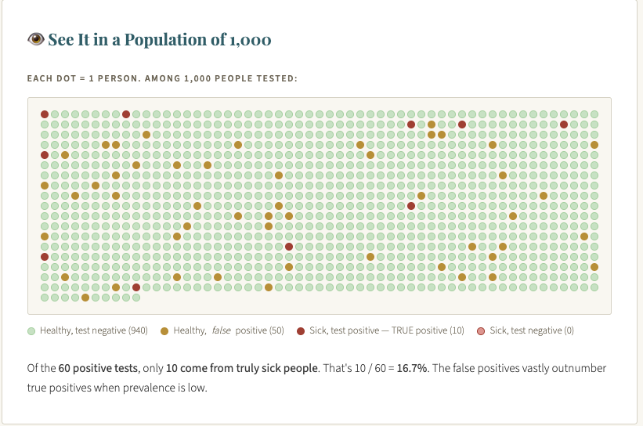

Slide 6
STEP-BY-STEP SOLUTION
Applying Bayes' Theorem
1
Establish the Prior — P(Disease)
P(Disease) = 0.01 P(Healthy) = 0.99
The base rate: disease affects 1% of people. This is our starting belief before any test.
2
Determine the Likelihoods
P(+ | Disease) = 0.99 P(+ | Healthy) = 0.05
How likely is a positive test under each hypothesis? 99% sensitivity; 5% false positive rate.
3
Compute the Total Probability of a Positive
P(+) = (0.99 × 0.01) + (0.05 × 0.99) = 0.0099 + 0.0495 = 0.0594
This is the denominator — overall probability of receiving a positive result.
4
Apply Bayes' Theorem
P(Disease | +) = (0.99 × 0.01) / 0.0594 ≈ 16.7%
Posterior probability of disease given a positive test.

Slide 7
SEE IT VISUALLY
1,000 People Walk In for Testing
10
50
The Surprise
True Positives
False Positives
Of 60 positive tests:
Sick & test positive
Healthy & test positive
10
940
0
truly sick
True Negatives
False Negatives
50
Healthy & test negative
Sick & test negative
false alarms
10 / 60 = 16.7%
Posterior probability

Slide 8
SENSITIVITY ANALYSIS
Why Priors Matter — Enormously
Keeping test accuracy fixed (sensitivity 99%, FPR 5%), watch how posterior changes with prevalence:
Key Insight
Same test.
Same accuracy.
Completely different posterior — depending on who gets tested.
This is why screening programs in low-prevalence populations require careful interpretation.

Slide 9



THE BIG IDEAS
What Bayesian Thinking Teaches Us
Priors Matter
Beliefs Are Fluid
Rare Events Are Tricky
Where you start your reasoning — your prior beliefs — shapes every conclusion you reach. Make your assumptions explicit and defend them.
Evidence should update belief, not replace it wholesale. Today's posterior becomes tomorrow's prior. Learning is iterative.
When base rates are low, even accurate tests produce mostly false positives. Always interpret evidence in context.
Today's posterior is tomorrow's prior.

Slide 10
Discussion
Questions to
Consider
In research, what serves as our 'prior' when we set out to understand or explain a phenomenon?
How should prior beliefs or working theories about shape interpretation of our analytic findings?
When is a Bayesian approach more informative than classical approaches?
Howard T. Everson · Advanced Data Analysis

